Slide 1

Presentation
on
CRYPTOGRAPHY
Group members
Bahadur Khan 20k-1081
Mukand Krishna 20k-0409
Yasir Hussain 20k
Bhavnesh Deep 20k-1085

Slide 2
Index
Introduction
What is Cryptography?
Purpose Of cryptography
Architecture of cryptography
Types of Cryptography
Process of cryptography
Types Of cryptography Algorithms
Attacks of cryptography
Conclusion

Slide 3
Introduction
The Internet or the global Internet is the internationally connected network of computer networks with addresses that are administrated by IANA (Internet address and Naming Authority).
There are many aspects to security and many applications, ranging from secure commerce and payments to private communications and protecting passwords. One essential aspect for secure communications is that of cryptography.

Slide 4
What is Cryptography?
Cryptography derived its name from a Greek word called “Krypto's” which means “Hidden Secrets”.
Cryptography is the practice and study of hiding information. It is the Art or Science of converting a plain intelligible data into an unintelligible data and again retransforming that message into its original form.
It provides Confidentiality, Integrity, and Accuracy.

Slide 5
PURPOSE OF CRYPTOGRAPHY
Authentication: ( The process of proving one's identity. (The primary forms of host-to-host authentication on the Internet today are name-based or address-based, both of which are notoriously weak.) )
Privacy/confidentiality: ( Ensuring that no one can read the message except the intended receiver. )
Integrity: ( Assuring the receiver that the received message has not been altered in any way from the original. )
Non-repudiation: ( A mechanism to prove that the sender really sent this message. )

Slide 6
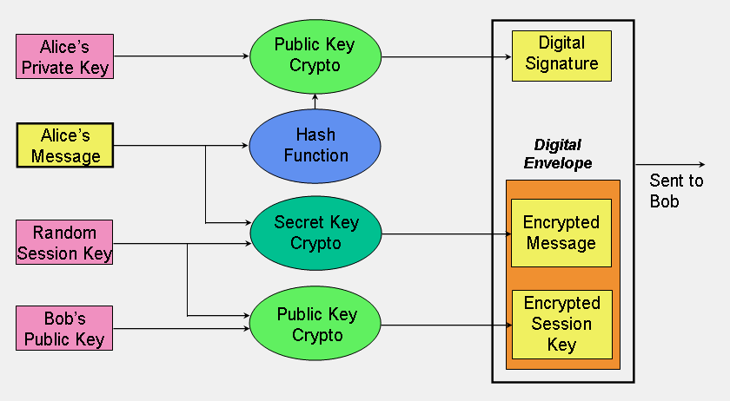
Architecture of cryptography

Slide 7
Types of Cryptography
Secret Key Cryptography
• Single key used to encrypt and decrypt.
• Key must be known by both parties.
• Assuming we live in a hostile environment (otherwise - why the need for cryptography?), it may be hard to share a secret key.

Slide 8
Public Key Cryptography
One of the keys allocated to each person is called the "public key", and is published in an open directory somewhere where anyone can easily look it up, for example by email address.
Each entity has 2 keys:
Private Key (a secret)
Public key (well known).

Slide 9
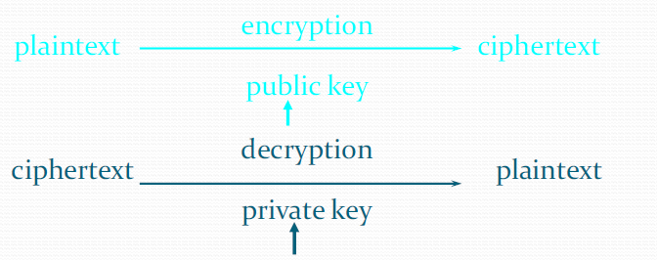
Using Keys
Private keys are used for decrypting.
Public keys are used for encrypting.

Slide 10
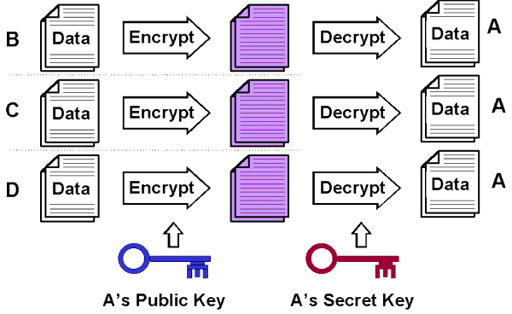
Process of cryptography

Slide 11
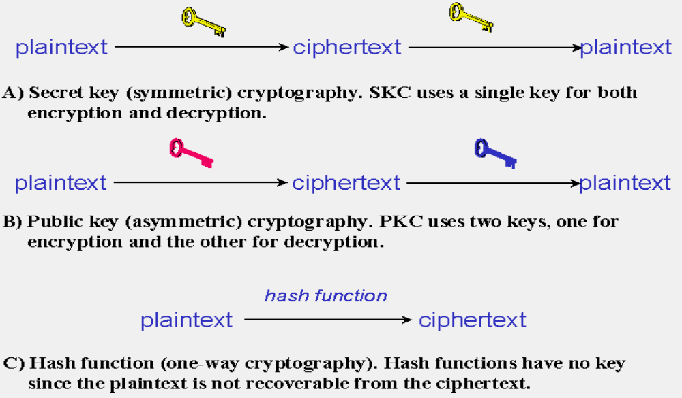
TYPES OF CRYPTOGRAPHIC ALGORITHMS

Slide 12
Public/Private Key Cryptography
Asymmetric key cryptography overcomes the key management problem by using different encryption and decryption key pairs. Having knowledge of one key, say the encryption key, is not sufficient enough to determine the other key - the decryption key.
The mathematical relationship between the public/private key pair permits a general rule: any message encrypted with one key of the pair can be successfully decrypted only with that key's counterpart.

Slide 13
Attacks of cryptography
Cipher text only attack
  The only data available is a target cipher text
Known plaintext attack
  A target cipher text
  Pairs of other cipher text and plaintext (say, previously broken or guessing)

Slide 14
Attacks of cryptography…
Chosen plaintext attacks
  A target cipher text
    Can feed encryption algorithm with plaintexts and obtain the matching cipher texts
Chosen cipher text attack
  A target cipher text
  Can feed decryption algorithm with cipher texts and obtain the matching plaintext matching cipher texts

Slide 15
CONCLUSION
We use different types of algorithms to establish security services in different service mechanisms.
We use either private key cryptography or public key cryptography according to requirement.
If we want to send message quickly we use private key algorithm and if we want to send messages secretly we use public key algorithm.

